Slide 1
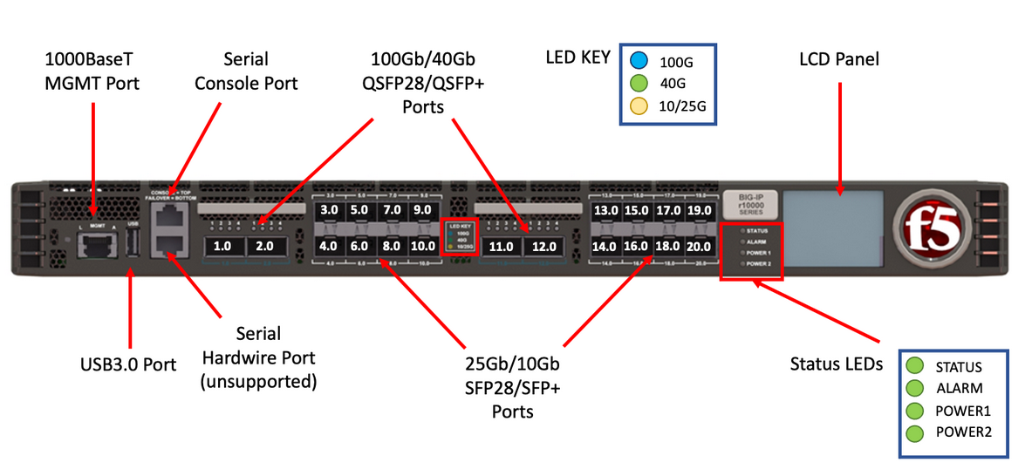
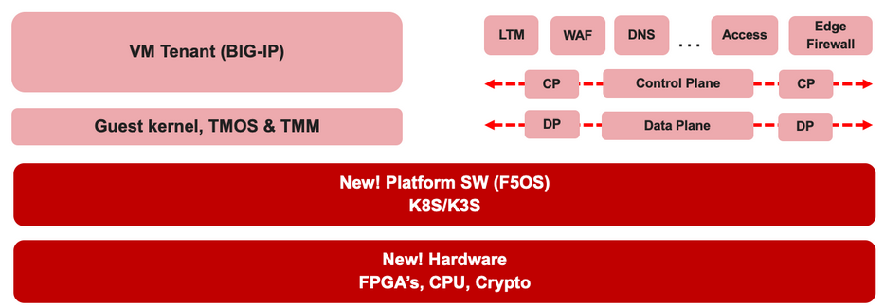

F5 rSeries Learning with
Alexander S

Slide 2
Agenda →
  iSeries to rSeries
  F5OS Basic Setup
  F5OS Upgrade Procedure
  VLAN and LAG Configuration
    Configure VLANs
    Configure LAG (Link Aggregation Group)
    Assign VLANs to the LAG
  Tenant OS Deployment Preparation
  Tenant OS Deployment
  rSeries Tenant Basic Setup
  High Availability (HA) in rSeries Tenants
    Best Practices for rSeries Tenant HA
    rSeries Tenant HA Configuration

Slide 3
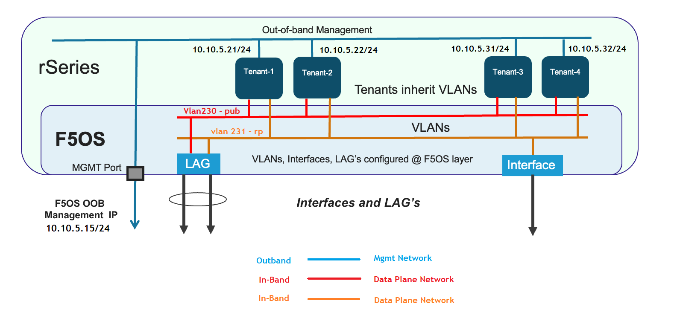
Chapter 4 - rSeries Networking
Part of this video, we will:
Deep dive into F5OS in-band and out-of-band networks.
Explore F5OS Port Groups and Pipeline Groups.
Design our lab’s physical and logical network connectivity
Set up VLANs, create LAGs, and assign VLANs to those LAGs

Slide 4
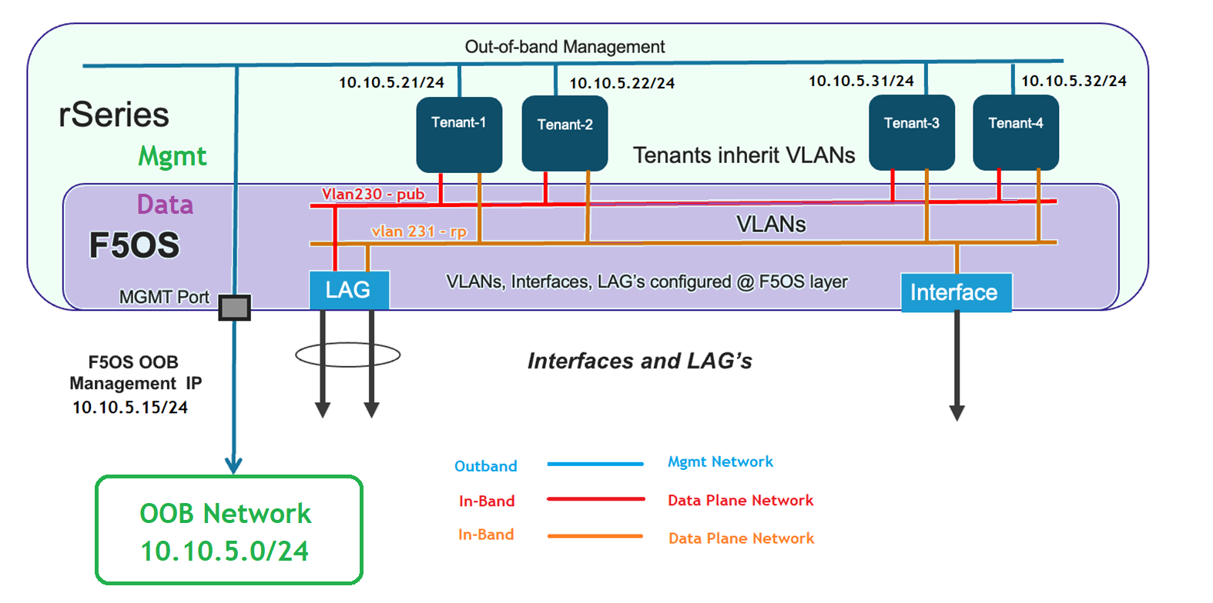
Chapter 4 - rSeries Networking
Section 01
Types of F5OS networking : Inband and Out-of-Band Networking

Slide 5
Chapter 4 - rSeries Networking
Types of F5OS networking
F5OS supports two types of networking:
  Out-of-Band Network - Used for the management plane.
  In-Band Network - Used for the data plane.

Slide 6
Chapter 4 - rSeries Networking
Types of F5OS networking – Out of band management network
Out-of-Band Network is for Management plane
The F5OS platform layer management is fully isolated from in-band traffic and VLANs.
Out of band IP address is only accessible through the out-of-band management network. (It cannot be accessed through in-band network).
In fact, the F5OS layer does not have any in-band IP addresses configured.
rSeries tenants automatically inherit the management VLAN from the F5OS layer.
Each tenant is assigned with a unique management IP address within the inherited VLAN.

Slide 7
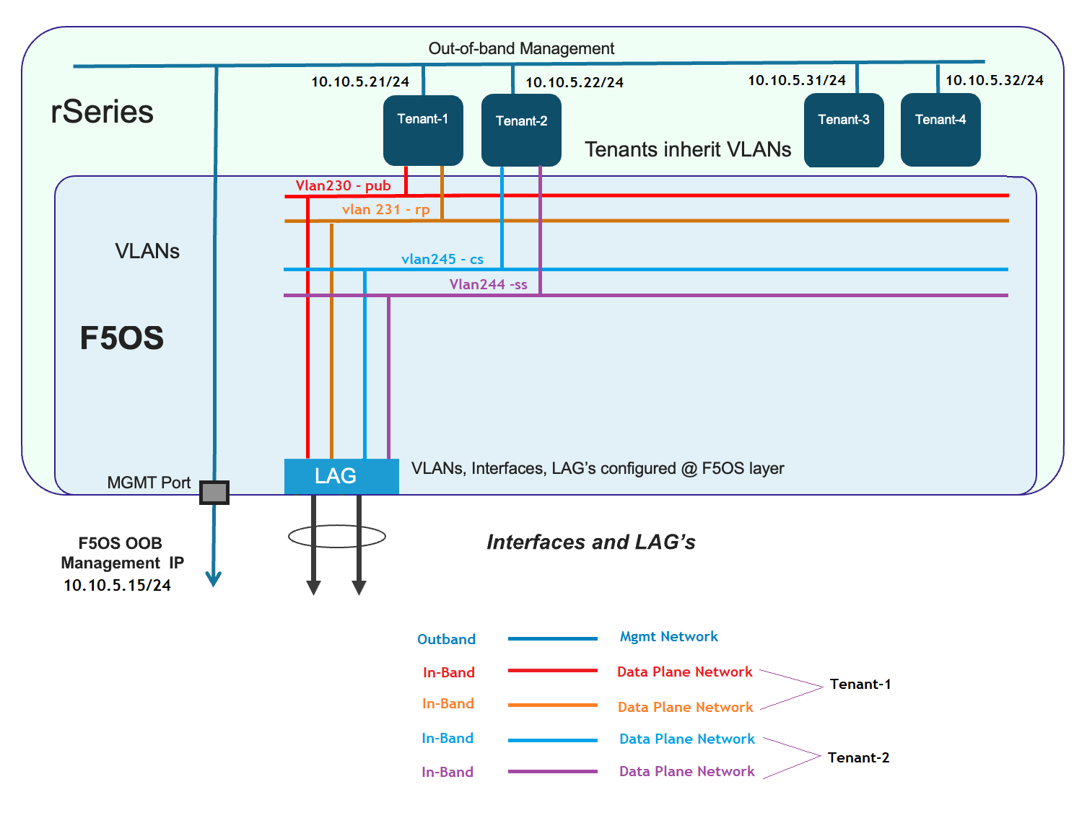
Chapter 4 - rSeries Networking
Types of F5OS networking – In band data plane networks
In-Band Network for Data Plane
All data-plane networking is configured at the F5OS host layer in rSeries.
F5OS (rSeries) uses Link Aggregation Groups (LAGs) for link aggregation.
VLANs are created and assigned to LAGs.
Tenants are created and assigned VLANs based on their specific requirements.
Tenants (rSeries) inherit only the VLANs they are explicitly permitted to access.

Slide 8
Chapter 4 - rSeries Networking
Types of F5OS networking – In band data plane networks
In-Band Network for Data Plane
All data-plane networking is configured at the F5OS host layer in rSeries.
F5OS (rSeries) uses Link Aggregation Groups (LAGs) for link aggregation.
VLANs are created and assigned to LAGs.
Tenants are created and assigned VLANs based on their specific requirements.
Tenants (rSeries) inherit only the VLANs they are explicitly permitted to access.

Slide 9
Chapter 4 - rSeries Networking
Section 01 - Done
Types of F5OS networking : Inband and Out-of-Band Networking
We understood the inband and out of band networking in F5 rSeries!!

Slide 10
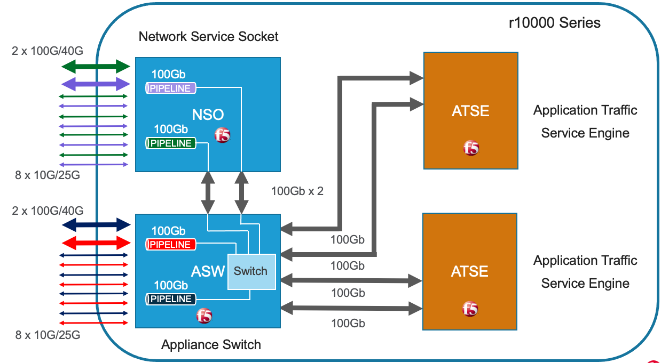
Chapter 4 - rSeries Networking
Section 02
Deep dive : Port Group & Pipeline Group in F5 rSeries

Slide 11



Chapter 4 - rSeries Networking
F5OS Port Group – Cake Cutting Game
To understand the port group let us play a game.
🎉 Birthday Cake Challenge
  Imagine you're at a birthday party with 8 friends, and you've got a 100-gram cake to share.

Slide 12
Chapter 4 - rSeries Networking
F5OS Port Group – Cake Cutting Game
🎯 Objective : Your goal is to divide the cake fairly among your friends by following the rules below.
👥 Friend Groups Rules
👥 Group A – Friends 1 to 4
Can only be served 10g each
Must serve either 2 or 4 friends (even number)
You may skip serving them
👥 Group B – Friends 5 to 8
Can be served either 10g or 25g each
If one gets 25g, all served must get 25g
If one gets 10g, all served must get 10g
Must serve either 2 or 4 friends (even number)
You may skip serving them
🔪 Cake Cutting Rules
The cake must be cut into no more than 8 pieces.
Each piece must be exactly 10g or 25g.
You cannot serve less than 10g to anyone.
You must serve at least 80g of the total cake.
The total cake served must not exceed 100g.
It’s okay to skip serving some friends.

Slide 13
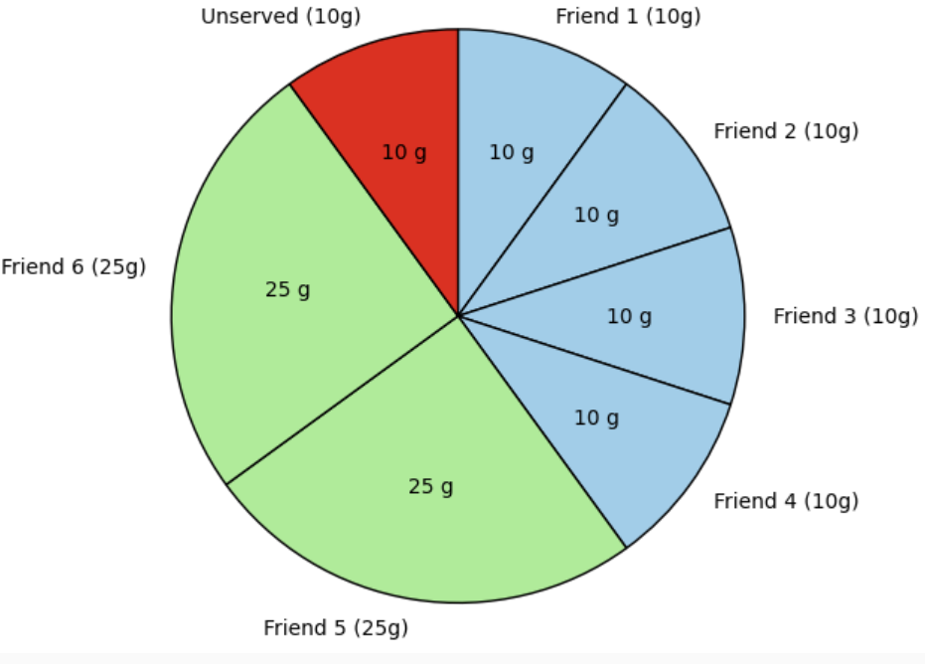
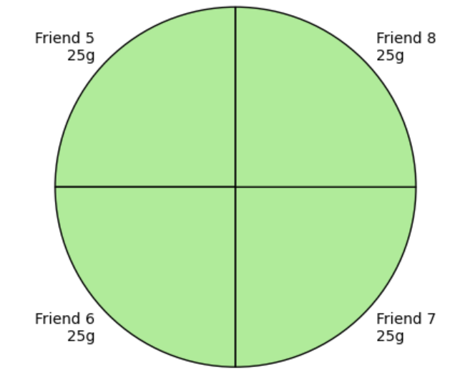
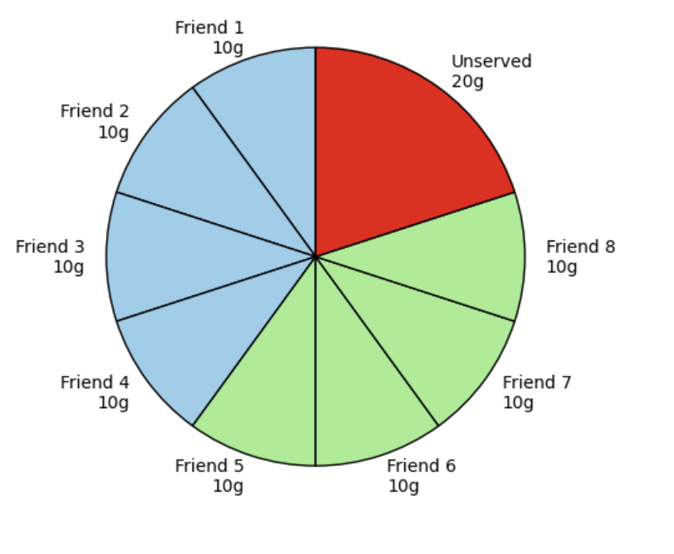
Chapter 4 - rSeries Networking
F5OS Port Group – Cake Cutting Game
✅ Serving Rules Summary
Rule Condition
Total pieces allowed Max 8
Allowed serving sizes Only 10g or 25g
Minimum total served At least 80g
Max total served No more than 100g
Per group servings Must serve 2 or 4 friends only
Group A limit Only 10g allowed per person
Group B consistency All must get either 10g or 25g (not both)
✅ Combination 2: Mixed Mode with 25g Boost
Group A: 4 friends × 10g = 40g
Group B: 2 friends × 25g = 50g
Total Cake Used: 90g
Valid: even numbers in both groups, meets 80g minimum, stays under 100g, uses 6 pieces.
✅ Combination 1: Balanced 10g Split
Group A: 4 friends × 10g = 40g
Group B: 4 friends × 10g = 40g
Total Cake Used: 80g
Meets all rules, uses minimum required amount (80g), fits in 8 pieces.
✅ Combination 3: Group B Feast
Group A: 0 friends served
Group B: 4 friends × 25g = 100g
Total Cake Used: 100g
Maxed-out serving, only Group B served, uses exactly 4 pieces.

Slide 14
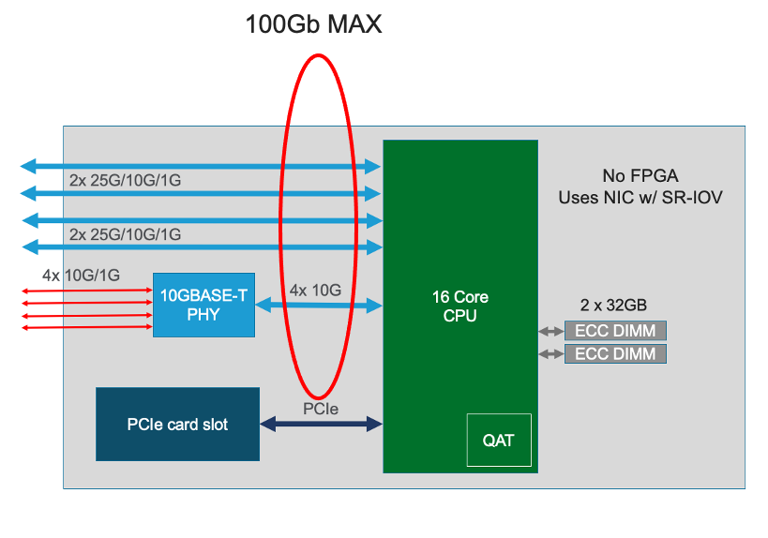
Chapter 4 - rSeries Networking
F5OS Port Group / Total Cake Size = Available Bandwidth
🍰 Cake = Bandwidth
The total size of the cake represents the available bandwidth capacity in an F5 system.
Just like in the game, you must not exceed this total capacity.
Nice Game! 🎉
Let’s now compare the cake-sharing game to how F5’s port-group and pipeline-group technology works:

Slide 15
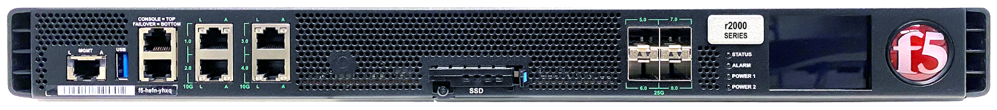

Chapter 4 - rSeries Networking
F5OS Port Group / Friend Groups = Media Types
The friend groups are like different media types, each with their own maximum supported port speeds.
Ethernet 1G/10G Ports
SFP 1G/10G/25G Ports
👥 Group B – Friends 5 to 8
Can be served either 10g or 25g each
If one gets 25g, all served must get 25g
If one gets 10g, all served must get 10g
Must serve either 2 or 4 friends (even number)
You may skip serving them
👥 Group A – Friends 1 to 4
Can only be served 10g each
Must serve either 2 or 4 friends (even number)
You may skip serving them

Slide 16
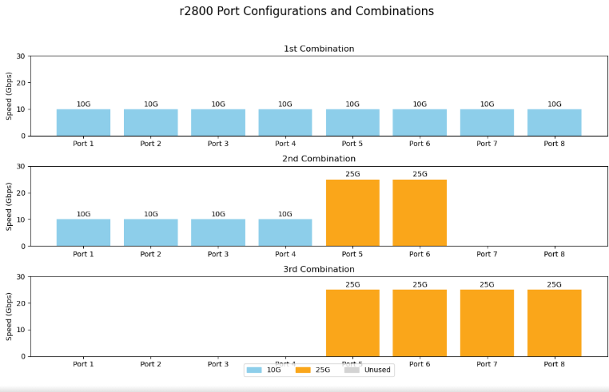
Chapter 4 - rSeries Networking
F5OS Port Group / Serving Combinations = Port-Group Profiles
Serving Combinations = Port-Group Profiles
The valid serving combinations in the game are similar to port-group profiles in F5.
F5 defines specific rules for how ports can be grouped and used - just like the game defined how cake could be shared.
The r2800 devices offers three distinct port profiles.
  Profile 1: 8 x 10Gb
  Profile 2: 4 x 10Gb & 2 x 25GB
  Profile 3: 4 x 25Gb

Slide 17
Chapter 4 - rSeries Networking
F5OS Port Group – Why we need to know about port group?
The rSeries 2800 hardware features:
4 x 1/10G copper physical ports
4 x 1/10/25G fiber physical ports

Slide 18
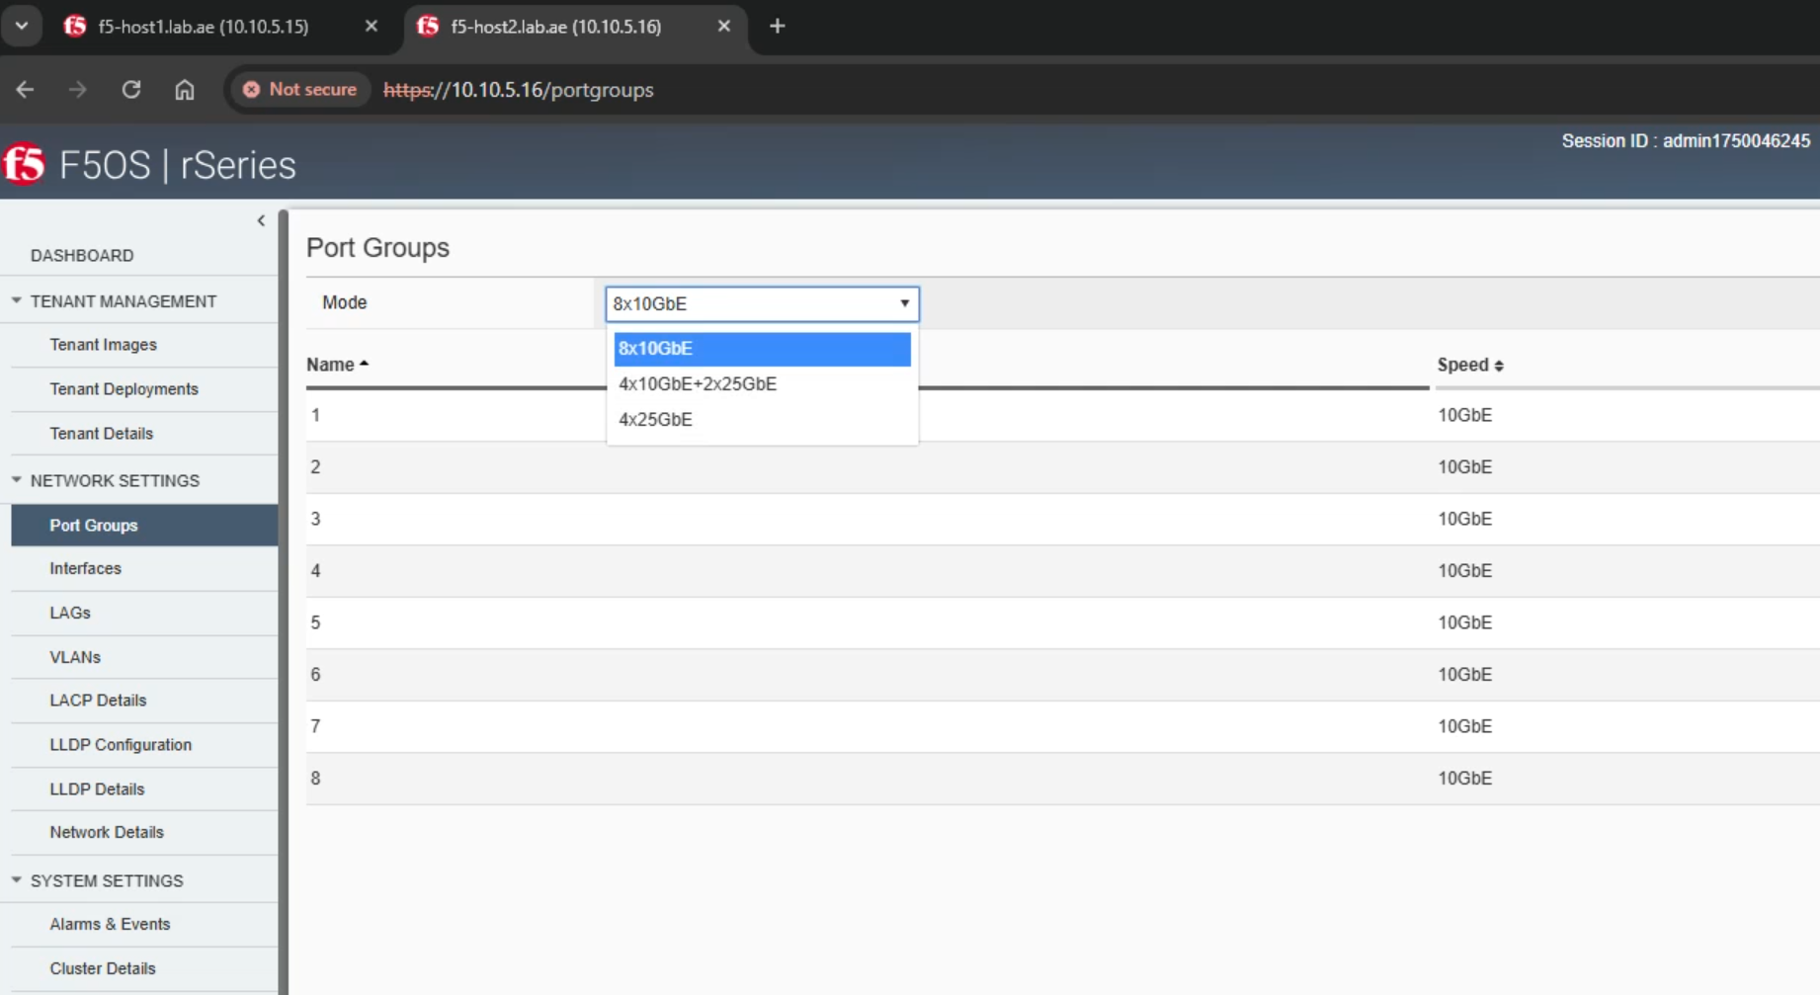
Chapter 4 - rSeries Networking
F5OS Port Group - Port Group Profiles
The r2800 devices offers three distinct port profiles.
  Profile 1: 8 x 10Gb
  Profile 2: 4 x 10Gb & 2 x 25GB
  Profile 3: 4 x 25Gb

Slide 19
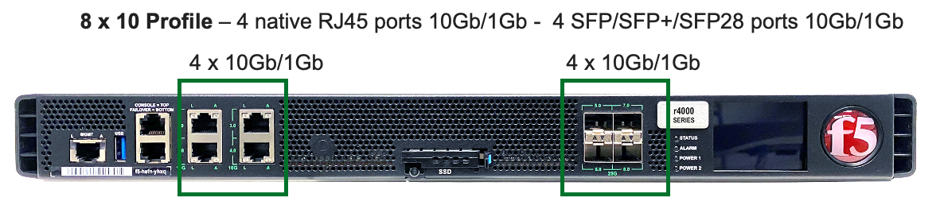
Chapter 4 - rSeries Networking
F5OS Port Group - 8 x 10Gb Mode
If you choose Profile 1 (8x10G Mode):
  Ports 1 to 4 (RJ45) operate at 10G each.
  Ports 5 to 8 (SFP) also operate at 10G each.
  The total bandwidth (maximum 80 Gbps) stays within the system limit of 100 Gbps.
Note: You cannot use 25G ports in this mode.

Slide 20
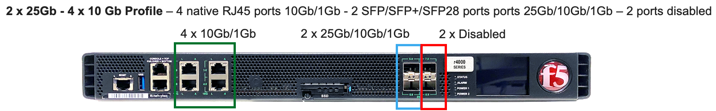
Chapter 4 - rSeries Networking
F5OS Port Group - 4 x 10Gb + 2 x 25G Mode
If you choose Profile 2 (4x10G + 2x25G Mode):
  Ports 1 to 4 (RJ45) operate at 10G each.
  Ports 5 and 6 (SFP) operate at 25G each.
  Ports 7 and 8 (SFP) are disabled by the system.
  The total bandwidth (4 × 10G + 2 × 25G = 90 Gbps) remains within the 100 Gbps system limit.
Note: In this mode, you cannot use more than four 10G ports.

Slide 21
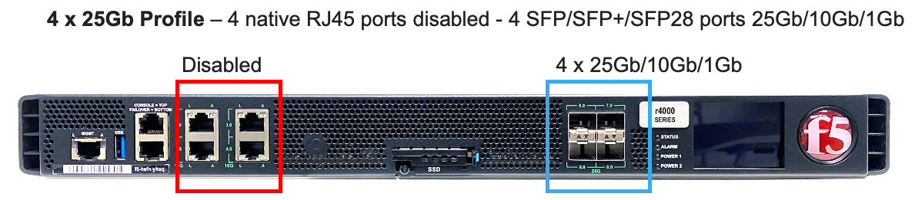
Chapter 4 - rSeries Networking
F5OS Port Group - 4 x 25G Mode
If you choose Profile 3 (4x25G Mode):
  Ports 1 to 4 (RJ45) are disabled.
  Ports 5 to 8 (SFP) operate at 25 Gbps each.
  Only four SFP ports are active.
  The total bandwidth remains within the 100 Gbps system limit.
Note: You cannot use 10G ports in this mode.

Slide 22
Chapter 4 - rSeries Networking
F5OS Port Group
A Port Group is a way to set up and organize the physical ports on an F5 rSeries device.
With a Port Group, possible of combination that tells the system:
    Which ports to use
    What speed each port should run at (like 10Gbps or 25Gbps)
    What type of cable or connector it uses (RJ45 or SFP)
    Which ports are active or disabled
      While defining a Port Group, it is essential to ensure that the total configured bandwidth does not exceed 100Gbps.
      You can apply one Port Group Profile to a pipeline group at a time.
      When a new port-group (PG) profile is applied to a pipeline group, the device reboots to reconfigure the ports, interface speeds, and modes accordingly.

Slide 23
Chapter 4 - rSeries Networking
F5OS Pipeline Group / One Cake = One Pipeline
Playing the game with one cake is like using one pipeline in F5.
Each pipeline supports a max bandwidth of 100Gb
All port-group rules apply within that single pipeline.

Slide 24
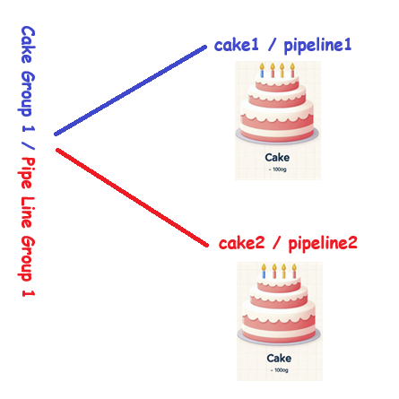
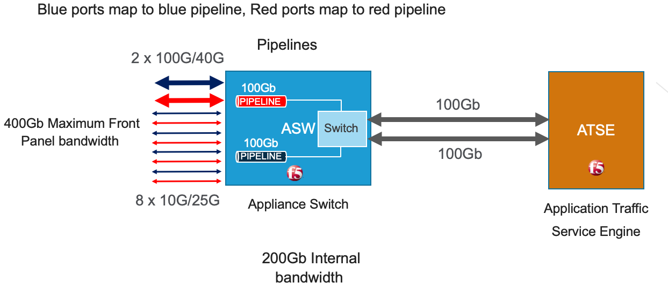
Chapter 4 - rSeries Networking
F5OS Pipeline Group / Two Cakes = Two Pipelines in a Pipeline Group
Using two cakes in the game is like using Pipeline 1 and Pipeline 2 under a single Pipeline Group 1 in F5.
In F5, a pipeline group can contain a maximum of two pipelines.

Slide 25
Chapter 4 - rSeries Networking
F5OS Max Pipeline Group supports
Every F5 rSeries device must have at least one pipeline.
A pipeline group contains two pipelines, each capable of 100 Gbps.
The maximum number of pipeline groups depends on the rSeries device model.
For example, the r10000 series supports two pipeline groups, totalling four pipelines.
One pipeline / r2800
Four pipelines / r1000

Slide 26
Chapter 4 - rSeries Networking
F5OS / why pipeline?
Alright! Why F5 dividing the hardware using pipeline ?
Two pipelines – r5800

Slide 27
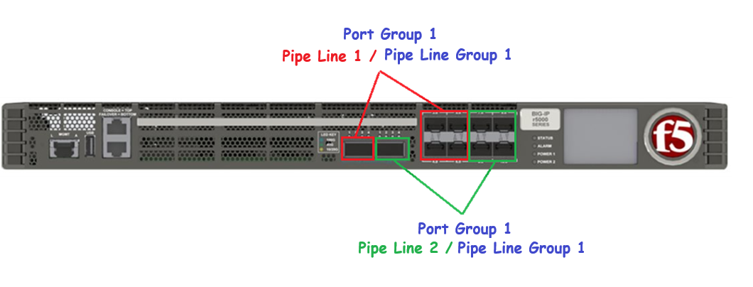
Chapter 4 - rSeries Networking
F5OS Pipeline Group – Hardware level separation
Pipeline Groups in F5 rSeries appliances provide physical hardware-level isolation by dividing the internal architecture into separate data processing pipelines, each with dedicated resources like:
CPU cores (TMMs)
Network interface queues
Memory access paths
R5800 Port Group and Pipeline Group

Slide 28
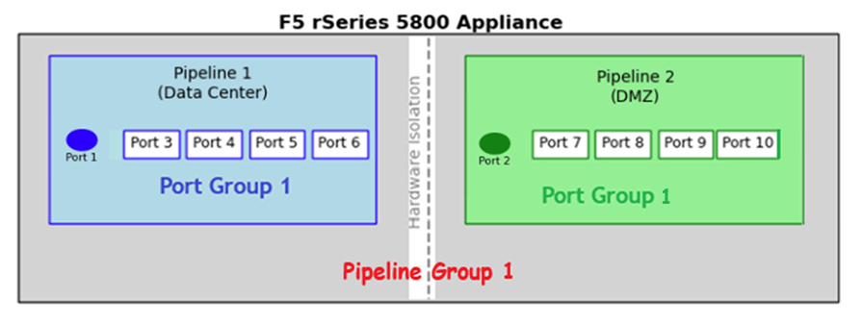
Chapter 4 - rSeries Networking
F5OS Different Pipeline for DC and DMZ networks for hardware isolation
The F5 rSeries 5800 appliance supports two pipelines within a single pipeline group, enabling isolated hardware-level traffic handling.
In this setup:
Pipeline 1 is assigned to the Data Center (DC).
  Port Group 1 maps ports 1, 3 through 6 to this pipeline 1.
Pipeline 2 is assigned to the DMZ.
  Port Group 1 maps ports 2, 7 through 10 to this pipeline 2.
This configuration provides strict hardware-based separation between the DC and DMZ environments, enhancing both security and performance.

Slide 29
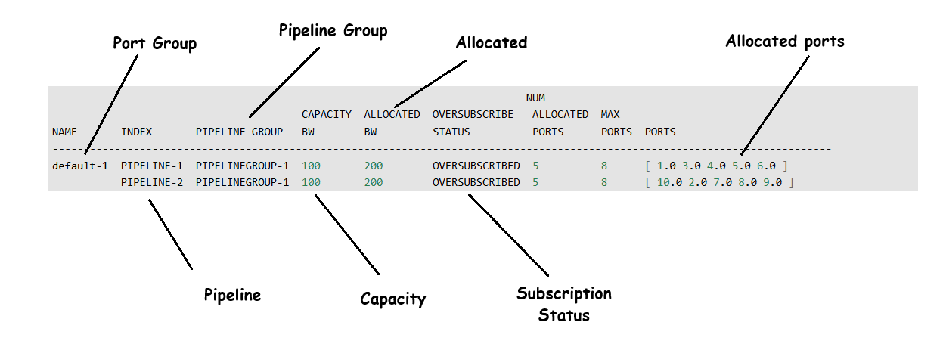
Chapter 4 - rSeries Networking
F5OS Pipeline Group - Oversubscription
In this R5800, you might see an oversubscription warning.
They give you two choices in pipeline 1:
  Use port number 1 as 100G or
  Use port numbers 3 to 6 as 25G each.
So, no worries! This way, we won’t end up with oversubscription.
They give you two choices in pipeline 2:
  Use port number 2 as 100G or
  Use port numbers 7 to 10 as 25G each.
So, no worries! This way, we won’t end up with oversubscription.

Slide 30
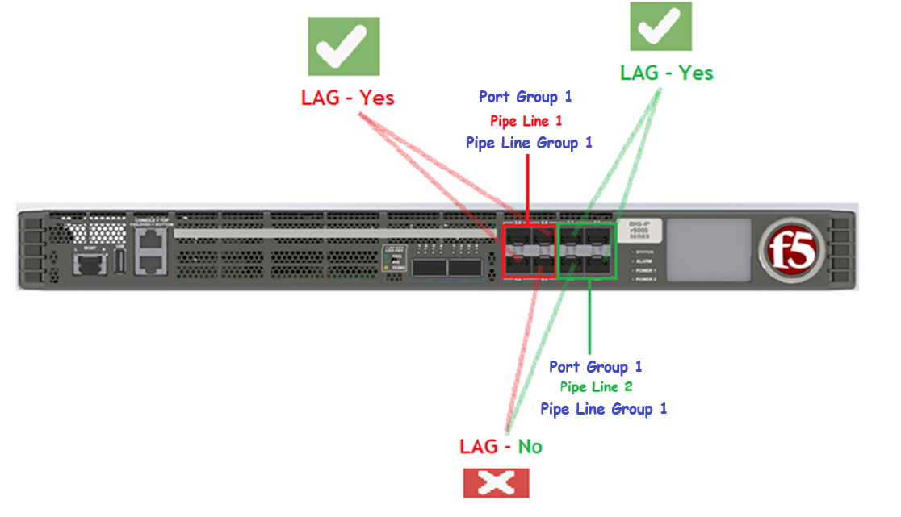
Chapter 4 - rSeries Networking
F5OS Pipeline technology – What you should know
The R2000 and R4000 models support only a single pipeline.
  So, you cannot do hardware-level separation using the lower end models r2000 & r4000.
Higher-end models support two pipelines within a pipeline group.
  When creating a LAG, all member ports must belong to the same pipeline within the pipeline group
    Because ports are physically tied to a specific pipeline.
In this example,
      Red-Pipeline: Ports 3 to 6 tied with pipeline1.
      Green-Pipeline: Ports 7 to 10 tied with pipeline2.
      You can form a LAG within Red Pipeline and Within Green Pipeline.
      However, you cannot create a LAG between RED and GREEN, as they are separated by pipeline technology.

Slide 31

Chapter 4 - rSeries Networking
Section 02 - Done
Deep dive : Port Group & Pipeline Group in F5 rSeries
We understood the Port Group & Pipe Line Group in F5 rSeries !!!

Slide 32
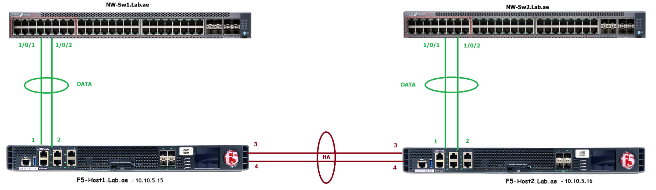
Chapter 4 - rSeries Networking
Section 03
LAB networks Design

Slide 33
Chapter 4 – rSeries Networking
Our LAB Design – Physical Layout
We have two rSeries 2800 hardware.
We name it as F5-Host1.Lab.ae & F5-Host2.Lab.ae.
We have configured with the management IP as
  F5-Host1.Lab.ae - 10.10.5.15
  F5-Host2.Lab.ae - 10.10.5.16
We configured the 8 x 10Gb port-group profile, allowing each port to function at a speed of 10G.
We chose to set up two LAGs: one for DATA and the other for HA.
  The DATA LAG (ports 1-2) is linked to the network switch (1/0/1-1/0/2).
  The HA LAG (ports 3-4) is interconnected.

Slide 34
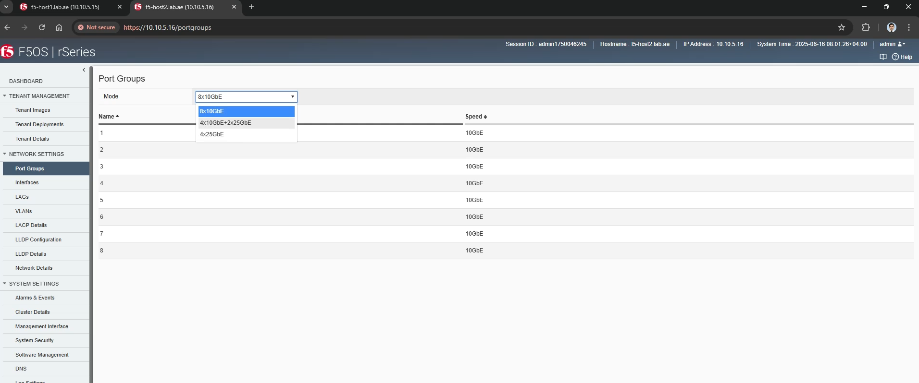
Chapter 4 - rSeries Networking
F5OS Port Group - Chooses 8x10G Port Groups
The r2800 devices offers three distinct port profiles.
  Profile 1: 8 x 10Gb
  Profile 2: 4 x 10Gb & 2 x 25GB
  Profile 3: 4 x 25Gb

Slide 35
Chapter 4 – rSeries Networking
Our LAB Design – Physical Layout
We have two rSeries 2800 hardware.
We name it as F5-Host1.Lab.ae & F5-Host2.Lab.ae.
We have configured with the management IP as
  F5-Host1.Lab.ae - 10.10.5.15
  F5-Host2.Lab.ae - 10.10.5.16
We configured the 8 x 10Gb port-group profile, allowing each port to function at a speed of 10G.
We chose to set up two LAGs: one for DATA and the other for HA.
  The DATA LAG (ports 1-2) is linked to the network switch (1/0/1-1/0/2).
  The HA LAG (ports 3-4) is interconnected.

Slide 36
Chapter 4 – rSeries Networking
LAB network design – LAG’s and Vlans
Task 01 - We need to set up Data vlans LAG on both rSeries 2800 devices.
Task 02 - The HA LAG needs to be configured on both rSeries 2800 devices.
Task 03 - We need to create the VLANs and assign them with the appropriate LAG.

Slide 37
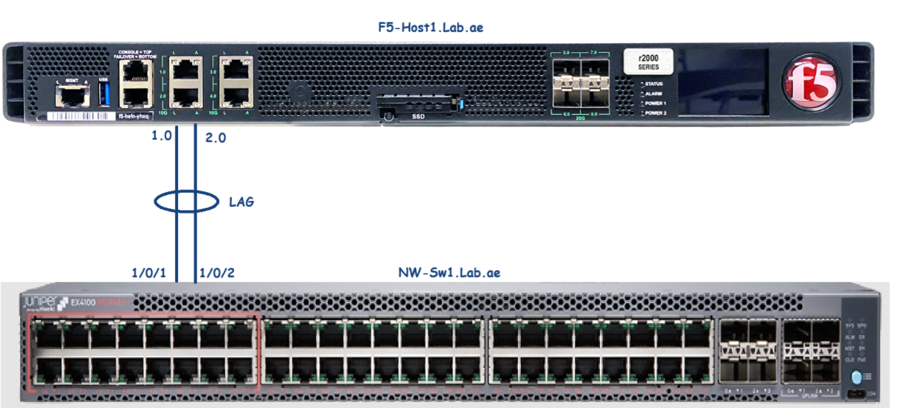
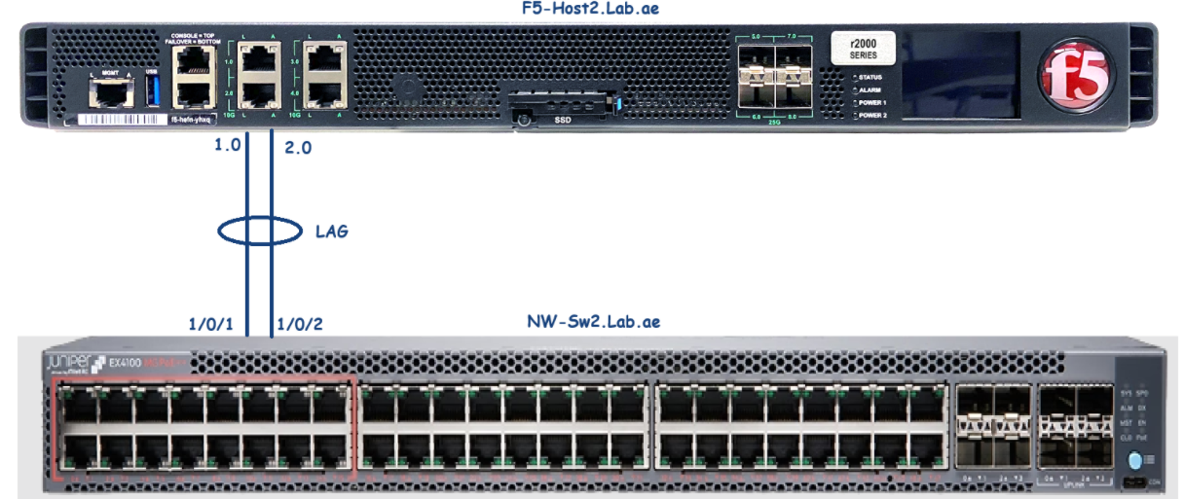
Chapter 4 – rSeries Networking
Task 01 - rSeries 2800 In-band (Data) LAG uplinks
F5-Host1.lab.ae to NW-Sw1 for DATA LAG
We need to set up Data vlans LAG on both rSeries 2800 devices.
Port 1 & 2 used for in-band DATA LAG uplinks
We have connected port 1 & 2 to network switch
On the network switch side Dynamic LAG is configured. Physical port status came up on the switch side. But LAG status is showing down.
In rSeries side, We have to verify the physical status, and it should show up.
We will configure dynamic LAG in rSeries host. Alright, let us do that now.
F5-Host2.lab.ae to NW-Sw2 for DATA LAG

Slide 38
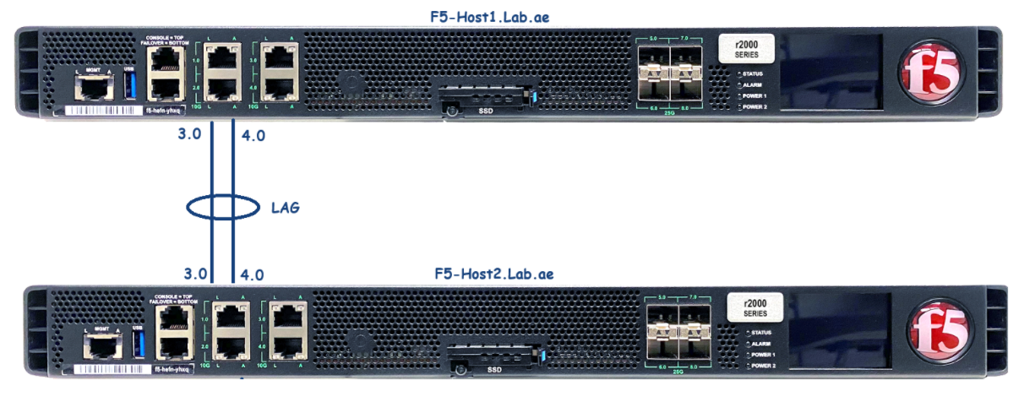
Chapter 4 – rSeries Networking
Task 02 - rSeries 2800 In-band (HA) LAG uplinks
F5-Host1.lab.ae to F5-Host2.lab.ae for HA LAG
The HA LAG needs to be configured.
Ports 3 and 4 are designated for in-band HA VLAN LAG uplinks.
F5-Host1.Lab.ae has ports 3 and 4 connected to the corresponding ports 3 and 4 on its peer, F5-Host1.Lab.ae.
We will set up a dynamic LAG utilizing ports 3 and 4 on both rSeries 2800 for HA.

Slide 39
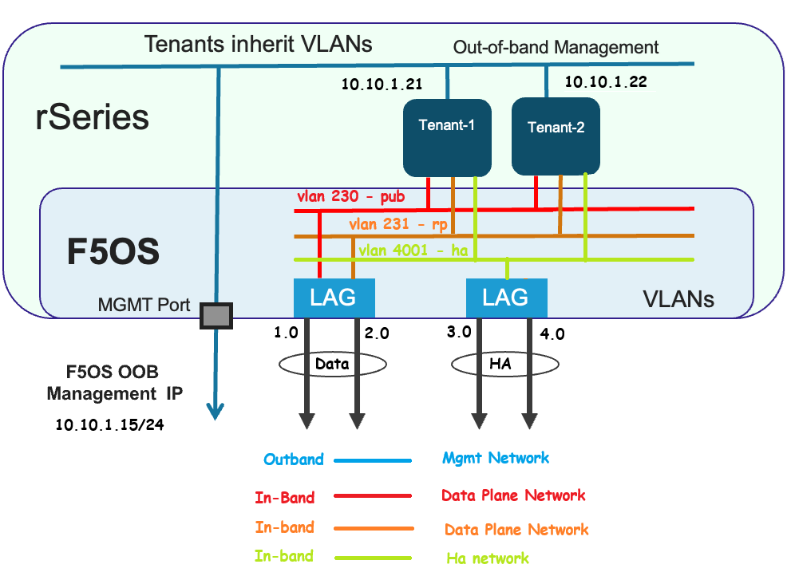
Chapter 4 – rSeries Networking
Task03 - Configure the vlans and add the vlans to LAG’s
For the deployment of tenant1, three VLANs are required.
  VLAN 230 - for publishing (client-side VLAN)
  VLAN 231 - for reverse proxy (server-side VLAN)
  VLAN 4001 - designated as the high-availability VLAN
It is necessary to create these VLANs and associate them with the corresponding LAG.
VLAN 230 and VLAN 231 should be assigned to DATA-LAG.
VLAN 4001 must be assigned to HA-LAG.

Slide 40
Chapter 4 - rSeries Networking
Section 03
LAB networks Design – Completed!!!

Slide 41
Chapter 4 – rSeries Networking
Section 4 - LAB networks configuration
Let’s proceed with
✅ Create the DATA and HA LAGs
🛠️ Create VLANs for the DATA and HA LAGs
🔗 Assign the appropriate DATA and HA VLANs to their respective LAGs

Slide 42
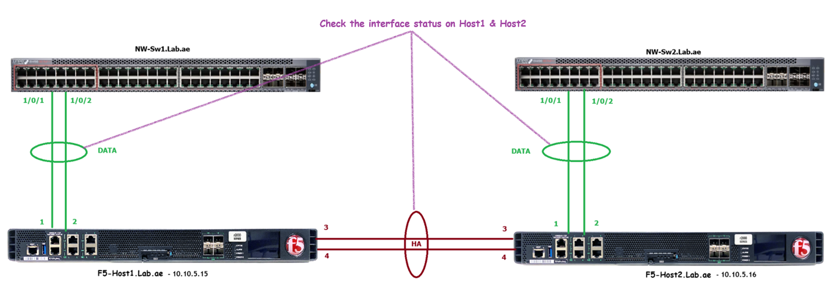
Chapter 4 - rSeries Networking
Check the interface status

Slide 43

Chapter 4 - rSeries Networking
Check the assigned port-group status

Slide 44
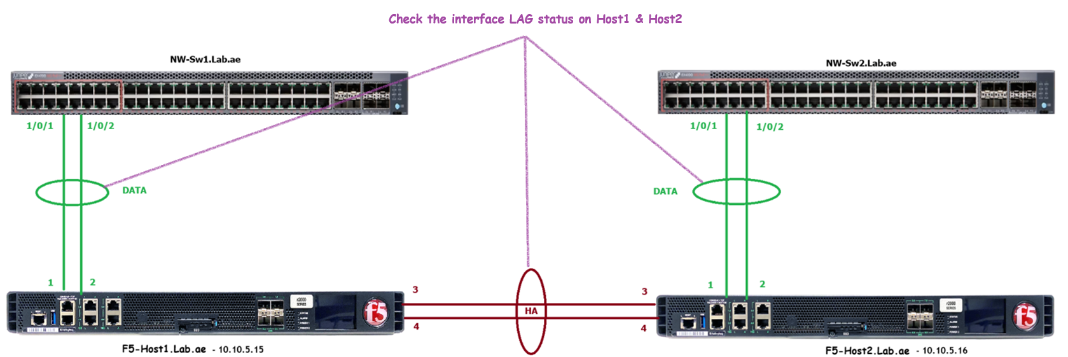
Chapter 4 - rSeries Networking
Check the interface LACP status

Slide 45
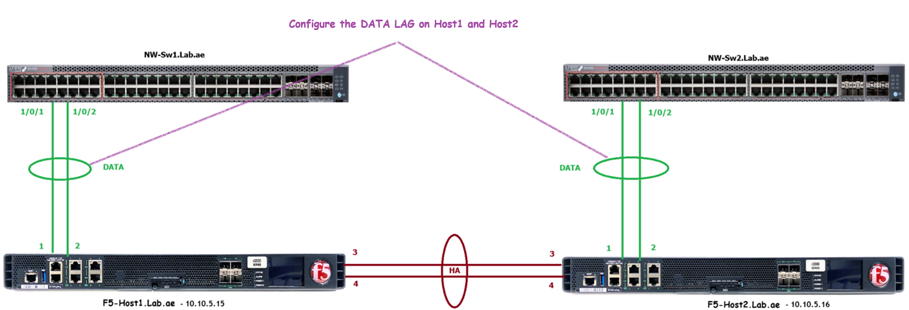
Chapter 4 - rSeries Networking
Configure the DATA LAG on Host1 & Host2

Slide 46
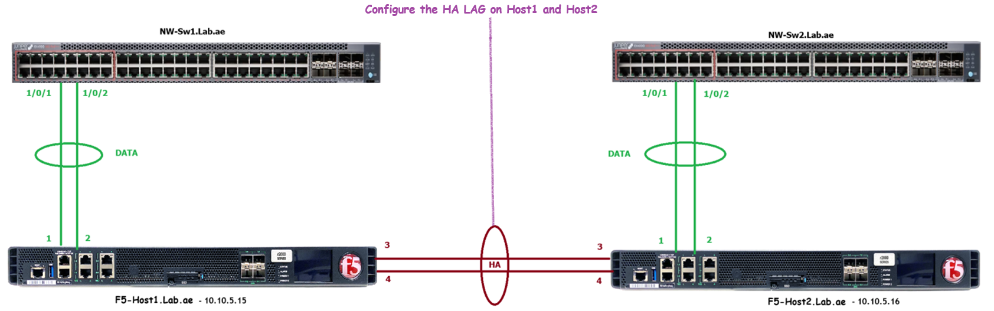
Chapter 4 - rSeries Networking
Configure the HA LAG on Host1 & Host2

Slide 47
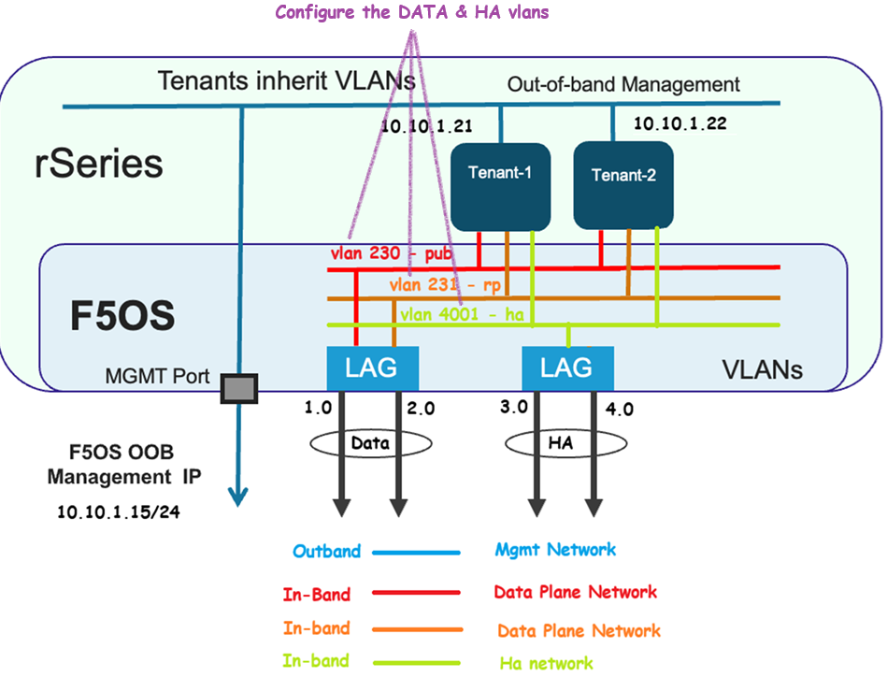
Chapter 4 - rSeries Networking
Configure the DATA & HA Vlans on Host1 & Host2

Slide 48
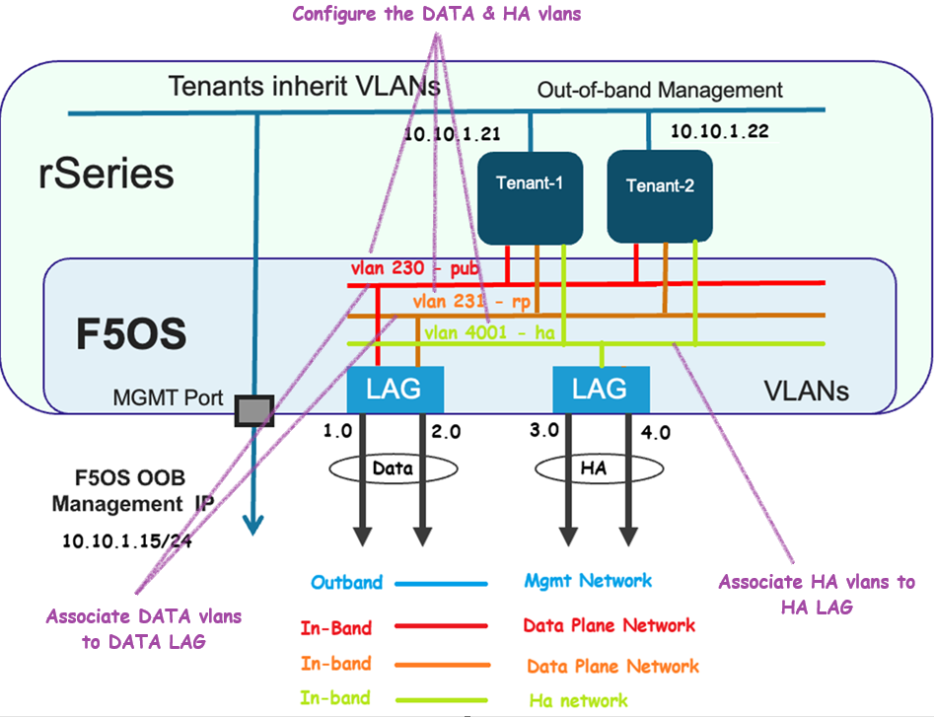
Chapter 4 - rSeries Networking
Configure the DATA & HA Vlans on Host1 & Host2

Slide 49
Chapter 4 – rSeries Networking
Section 4 - LAB networks configuration - Done
We have,
✅ Created the DATA and HA LAGs
✅ Configured VLANs for both DATA and HA LAGs
✅ Assigned the appropriate VLANs to their respective LAGs

Slide 50
Great! We just took a deep dive into how networking works on the rSeries platform.
We also set up the physical and logical connectivity for our Lab.ae network, including the Mgmt, DATA and HA networks.

Slide 51
Please continue by watching the next video.
Next video is – Tenant OS Deployment Preparation – Thank you!!!

